Slide 1
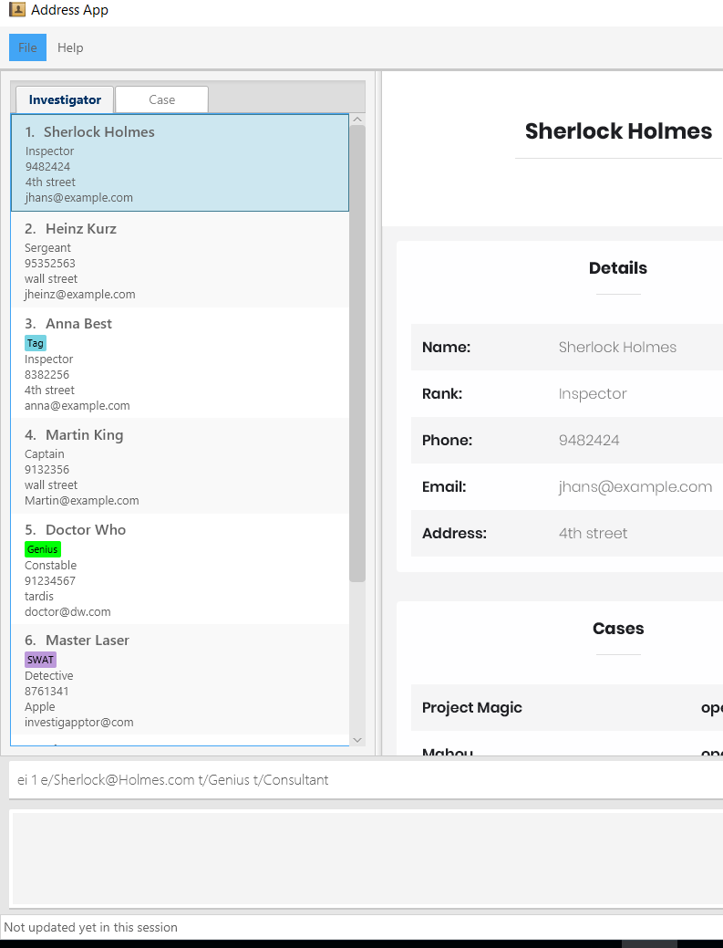
1. Use the index to indicate which Investigator you want to edit
2. Enter the details that you want to change

Slide 2
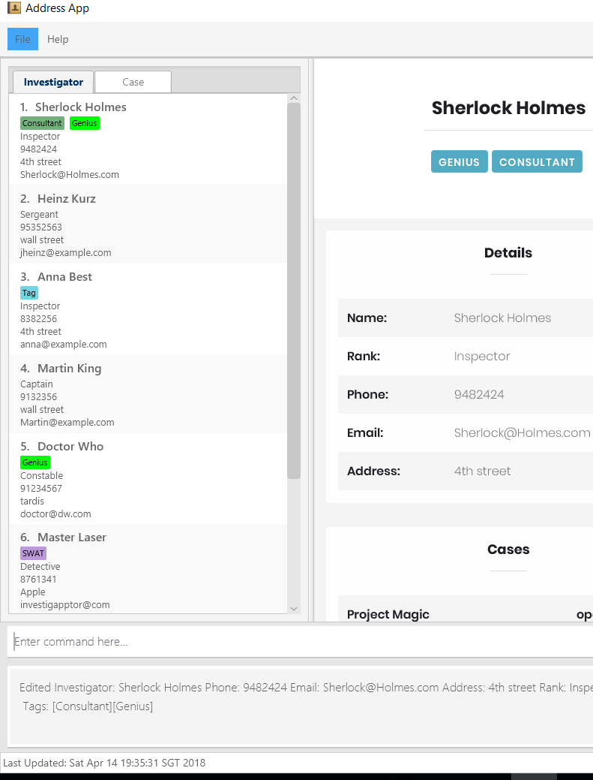
Changes will be seen in both the panel list and the detail panel
2. Changes made to the investigator will be indicated here as a success message

Slide 3
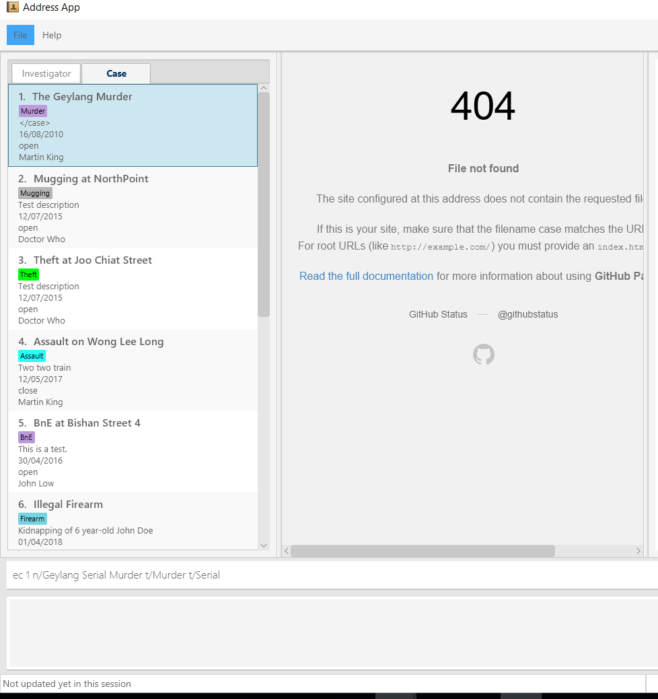
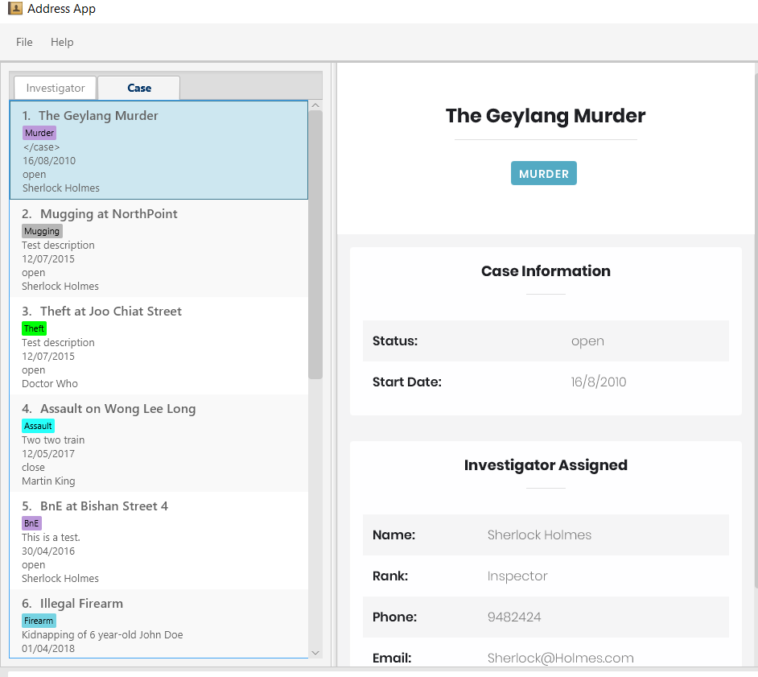
1. Use the index to indicate which case you want to edit
2. Enter the details that you want to change

Slide 4
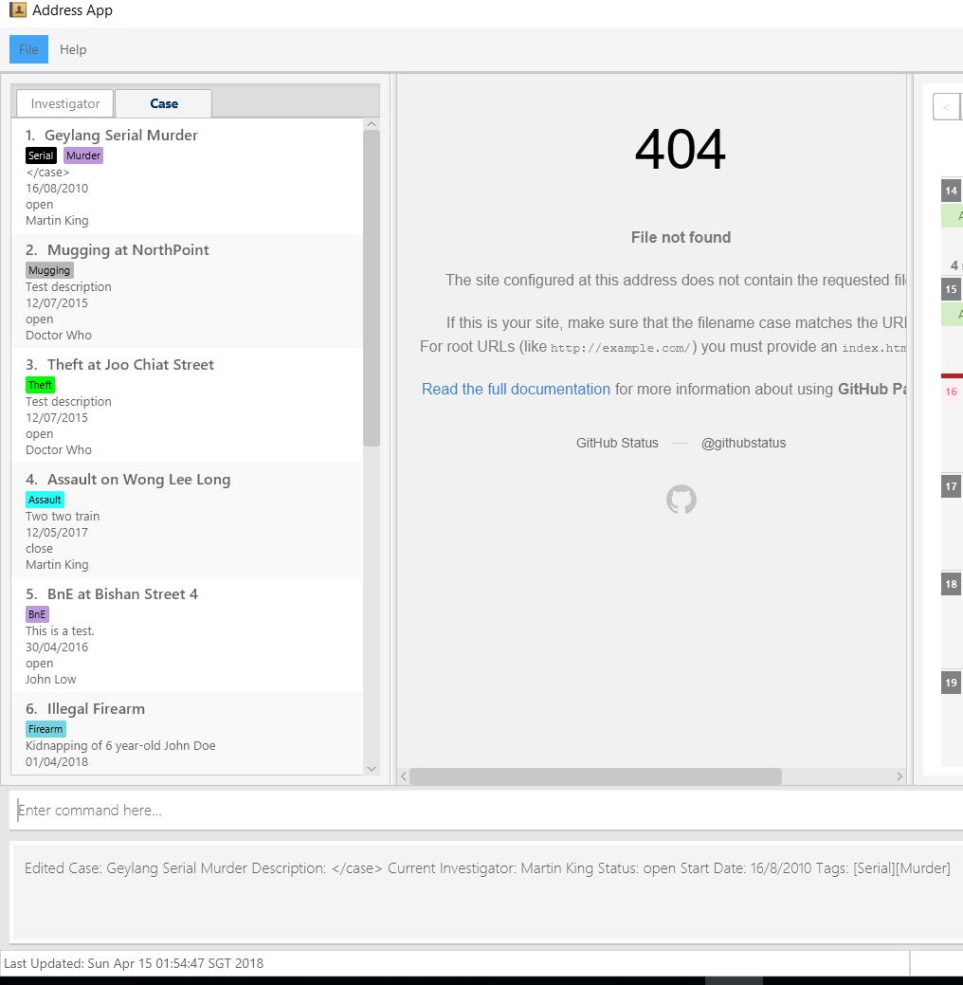
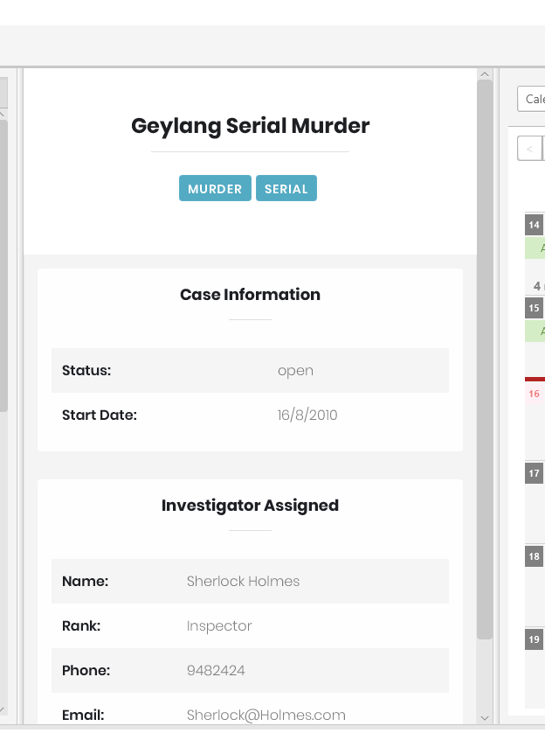
Changes will be seen in both the panel list and the detail panel
2. Changes made to the case will be indicated here as a success message

Slide 5
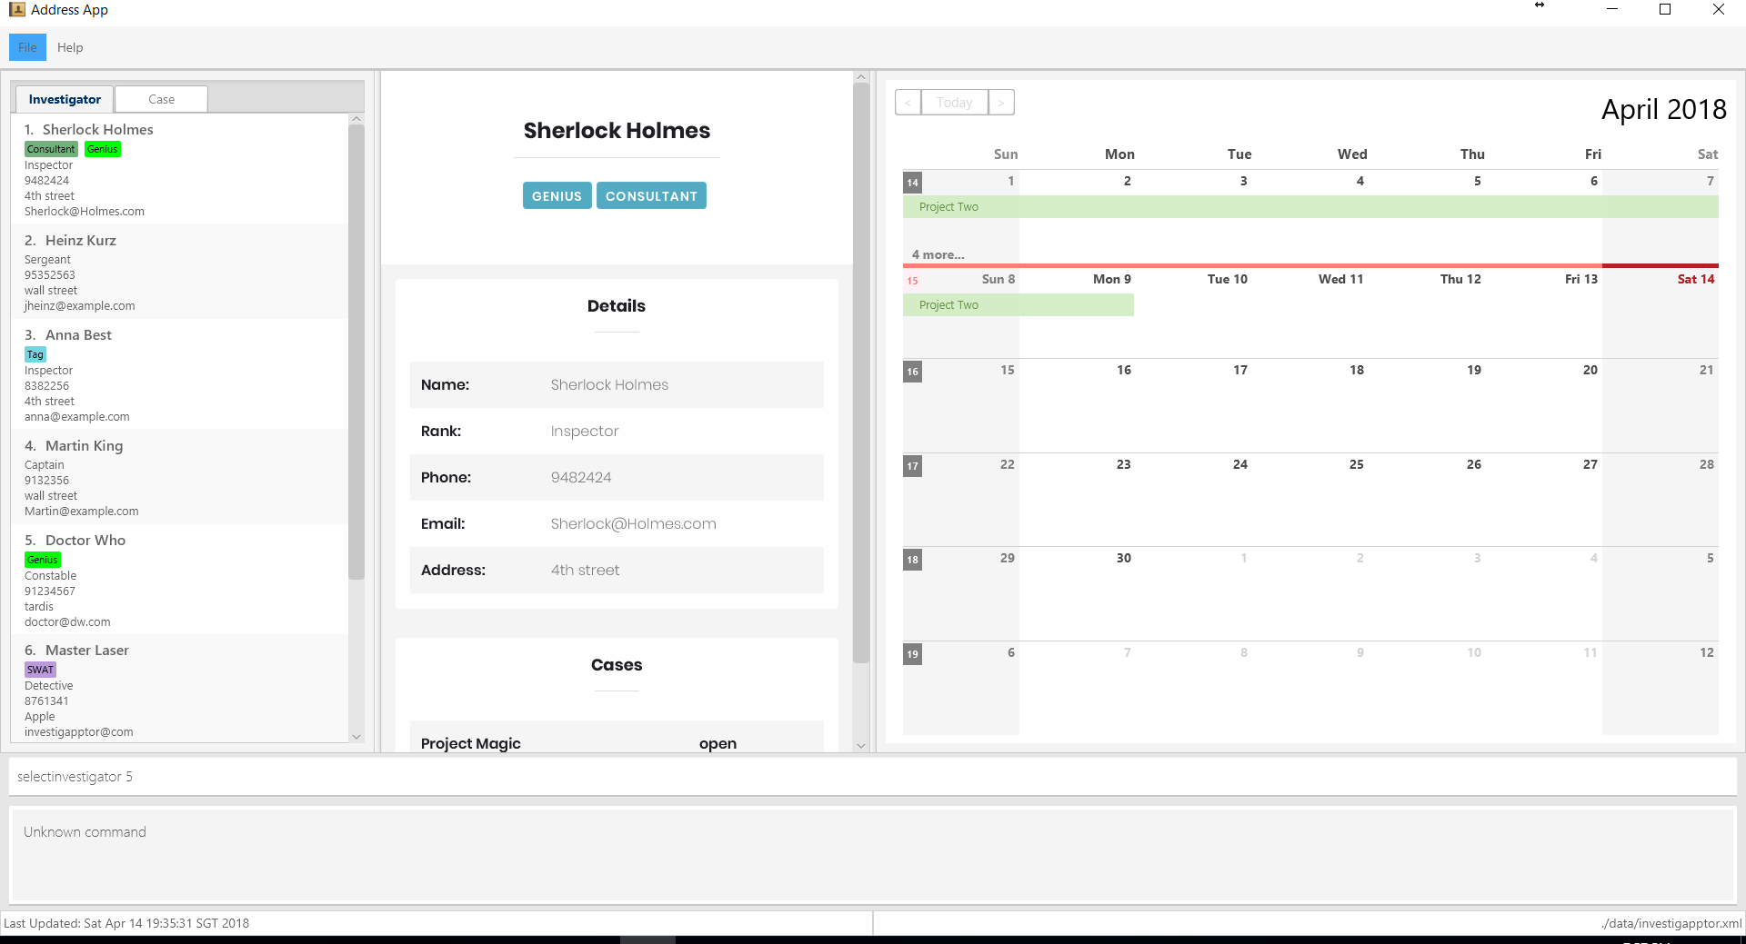

Slide 6
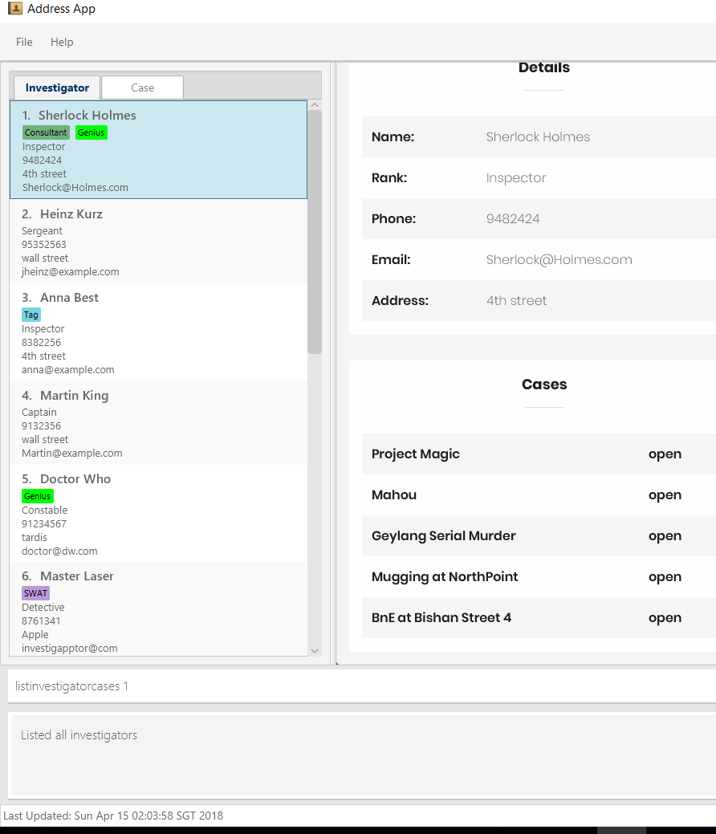
1. Use index to indicate which investigator’s cases you want to view

Slide 7
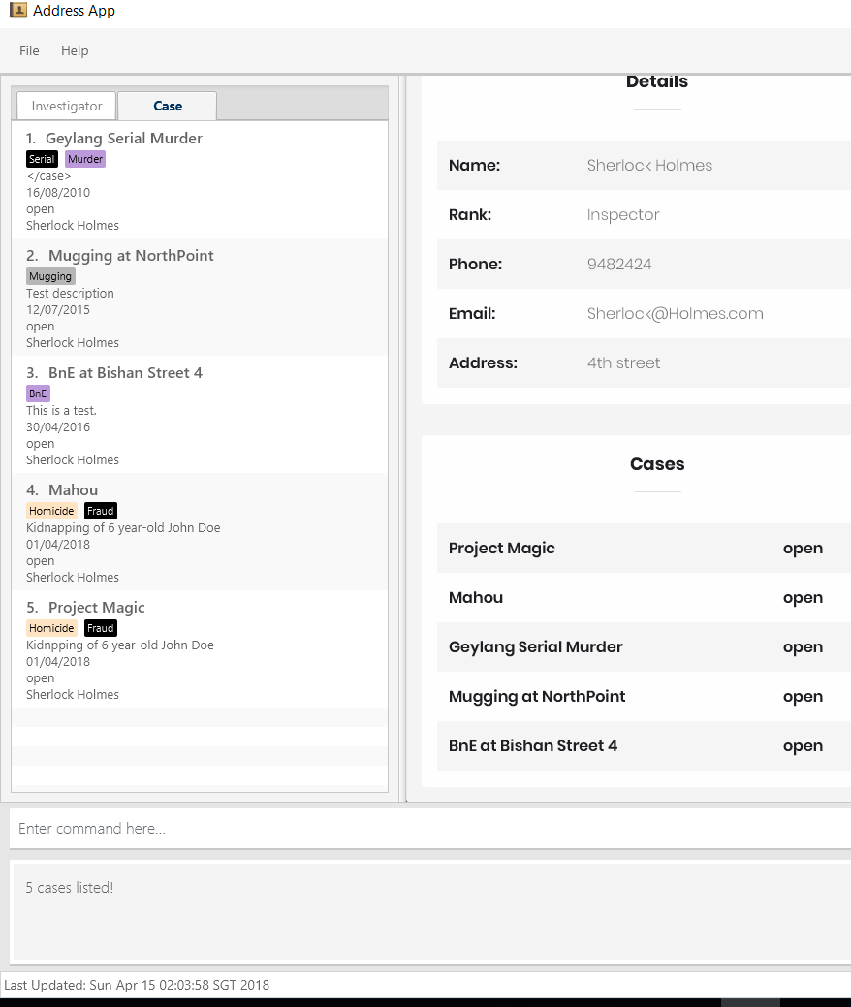
The cases under the investigator are now displayed on the list panel
Success message show how many cases belong to the selected investigator

